Slide 2


Slide 3






Slide 4
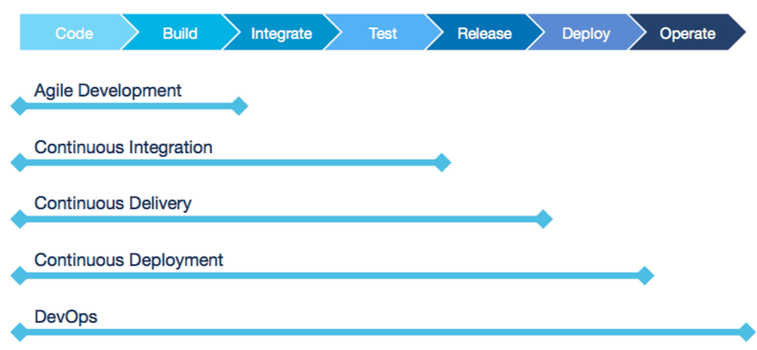

Slide 5

DEV
OPS
Communicate
Integrate
Collaborate

